Slide 1

The Impact of COVID-19 on Agriculture in Thailand
(Session II)
Nipon Poapongsakorn, Distinguished Fellow
Urairat Jantarasiri, Researcher
PRCI Webinar Series: Covid-19 Policy Analysis and Responses in Thailand Jointly organized by IFPRI-MSU-KU-TDRI
September 30, 2020

Slide 2
Key messages
Macro impact of Covid-19
  Thailand has been praised as one of the top countries that successfully contained the Covid-19 pandemic, yet the successful health policy has come with a high economic cost.
Impact on agriculture
  The “direct impact” on agriculture GDP was relatively mild, comparing to that of the top three most affected sectors, which have high linkage with the tourist industry, i.e. (1) accommodation & food service, (2) art entertainment & recreation, and (3) transport & storage,
  Two main channels of direct impacts are:
    Supply chain and logistics disruption both in international trade and domestic trade during the period of lockdown & curfews
    Reduction in demand by both foreign tourists and Thais, caused by a ban on international travel, business lockdown, and WFH measures
  Yet “indirect impact” on agricultural households is more serious than direct impact, caused by reverse migration
    Farm households lost large sum of income from non-agricultural sector, which accounted for 65%-74% of their household income.
    Laid-off workers in the non-agri sector, who came back to their farm families, must survive on agricultural income of 26%-35%
    Many farm households, particularly the poor, have become highly vulnerable

Slide 3
Key messages (cont.)
Government responses
  The cash handout is the major single policy to mitigate the Covid-19 impact on household income, while the softy loan measures are quickly implemented to resolve the looming debt problems of business and small borrowers
  Although the cash handout is a semi-universal program, it has two serious errors (a) inclusion errors, (b) exclusion errors, particularly the poor who do not have access to smart phone or do not know how to register online
  Most family members of agricultural households are entitled to receive the cash handout from one of four policy channels
  Yet some of 4.5 family members who work in the non-agricultural sector do not receive any subsidy because their names are in the farmer registration system

Slide 4
Key messages (cont.)
Government responses (cont.)
  The medium-term policies of economic restructuring and employment creation have slow progress and the existing 46,111 project proposals may not achieve the objectives of employment creation and economic restructuring due to the inherent weakness of project formulation by the bureaucrats
Implications for the economic restructuring policy
  Three major concerns about the current restructuring programs (using 400 billion baht of loan) are raised
  The speakers also identify three policy challenges

Slide 5
A poll: two policy questions

Slide 6
Outline
Objectives and Methodology
Policy response timeline
Macroeconomic impact
Impact on Thai agriculture
Government responses: Does the cash handout help mitigate the shocks?
Implication for the restructuring programs

Slide 7
Objectives and Methodology
Objectives
  To describe the timeline of economic policy to mitigate impact of Covid-19
  To briefly present the macroeconomic impact of Covid-19
  To analyze the direct and indirect impact of Covid-19 on Thai agriculture
  To explain the policy response, emphasizing policies that affect agricultural households
  To draw some policy implications
Methodology
  Using a qualitative method to assess the economic policies
  Using secondary data and drawing from some findings of previous studies
Hypothesis: direct impact on agriculture production is not so serious as the indirect impacts on agricultural household income

Slide 8
I. Policy Response Timeline

Slide 9
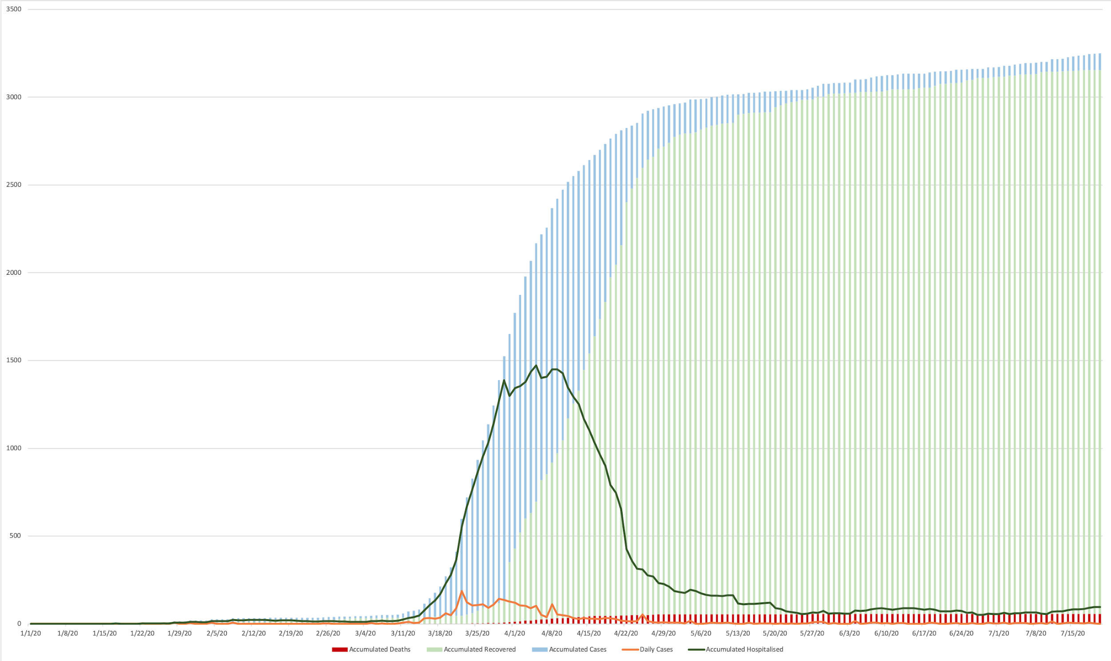
Thailand has been praised as one of the world most successful countries in containing Covid-19
Thailand was able to identify the world first Covid-19 infected case outside China due to prompt and effective surveillance system
It has managed to flatten the new infection curve and prevent new infection in a short time period, thanks to the professional disease control management, effective and credible public communication as well as public cooperation in adopting essential preventive measures, especially mask wearing, social distancing, and efficient tracing by the network of village health volunteers
This second webinar wants to describe the economic policy response and qualitatively assess its impact in the short-term
14 Jul: Egyptian soldier & Sudanese Diplomat’s daughter incidents
4 May: 1st day of no domestic infection
9 Mar: Thonglor ent. venue incident
There was only one local infection
In the last 127 days,
(as of 30 September)
6 Mar: Boxing Stadium incident
4 Feb: Thai citizens returned from Wuhan
3 Mar: Thai workers returned from Rep. Korea
31 Jan: 1st local transmission
1 Mar: 1st death
13 Jan: 1st case in Thailand

Slide 10
Policy responses timeline
17 May: Easing II
Curfew: 11 PM – 4 AM
15 Jun: Easing IV
Curfew revocation
1 Jul:
Easing V
Government spending has helped to mitigate
the impacts of COVID-19 on individuals, but the amount
is limited and speed is slow.
There were three phase of government response started at 10th March until now, the total budget line of government response is 2 trillion baht (14% of GDP).
19 Apr: Gov’t approved 3 Royal Decrees to borrow money 1.9 trillion baht
1 Jun: Easing III
Curfew: 11 PM – 3 AM
18 Apr: Active cases Finding in risk-prone areas
3 May: Easing I
8 Apr: financial aid 15,000 baht/person
“Nobody will be left behind”
9 Jul: Economic & Social rehabilitation projects were approved 92 billion baht from 400 billion baht
7 Apr: Active cases Finding in risk-prone groups
6 Apr: Int. Flights ban
3 Apr: Imposing Curfew: 10 PM – 4 AM
2 Apr: Imposing State Quarantine
26 Mar: Emergency Decree³
22 Mar: BKK Lockdown²
Economic policies
20 Mar: Monetary policy – BOT buy Gov’t bond 100 billion baht
Health policies
17 Mar: Free test for Patient Under Investigation
3 Jan: Health checks at int. airports

Slide 11
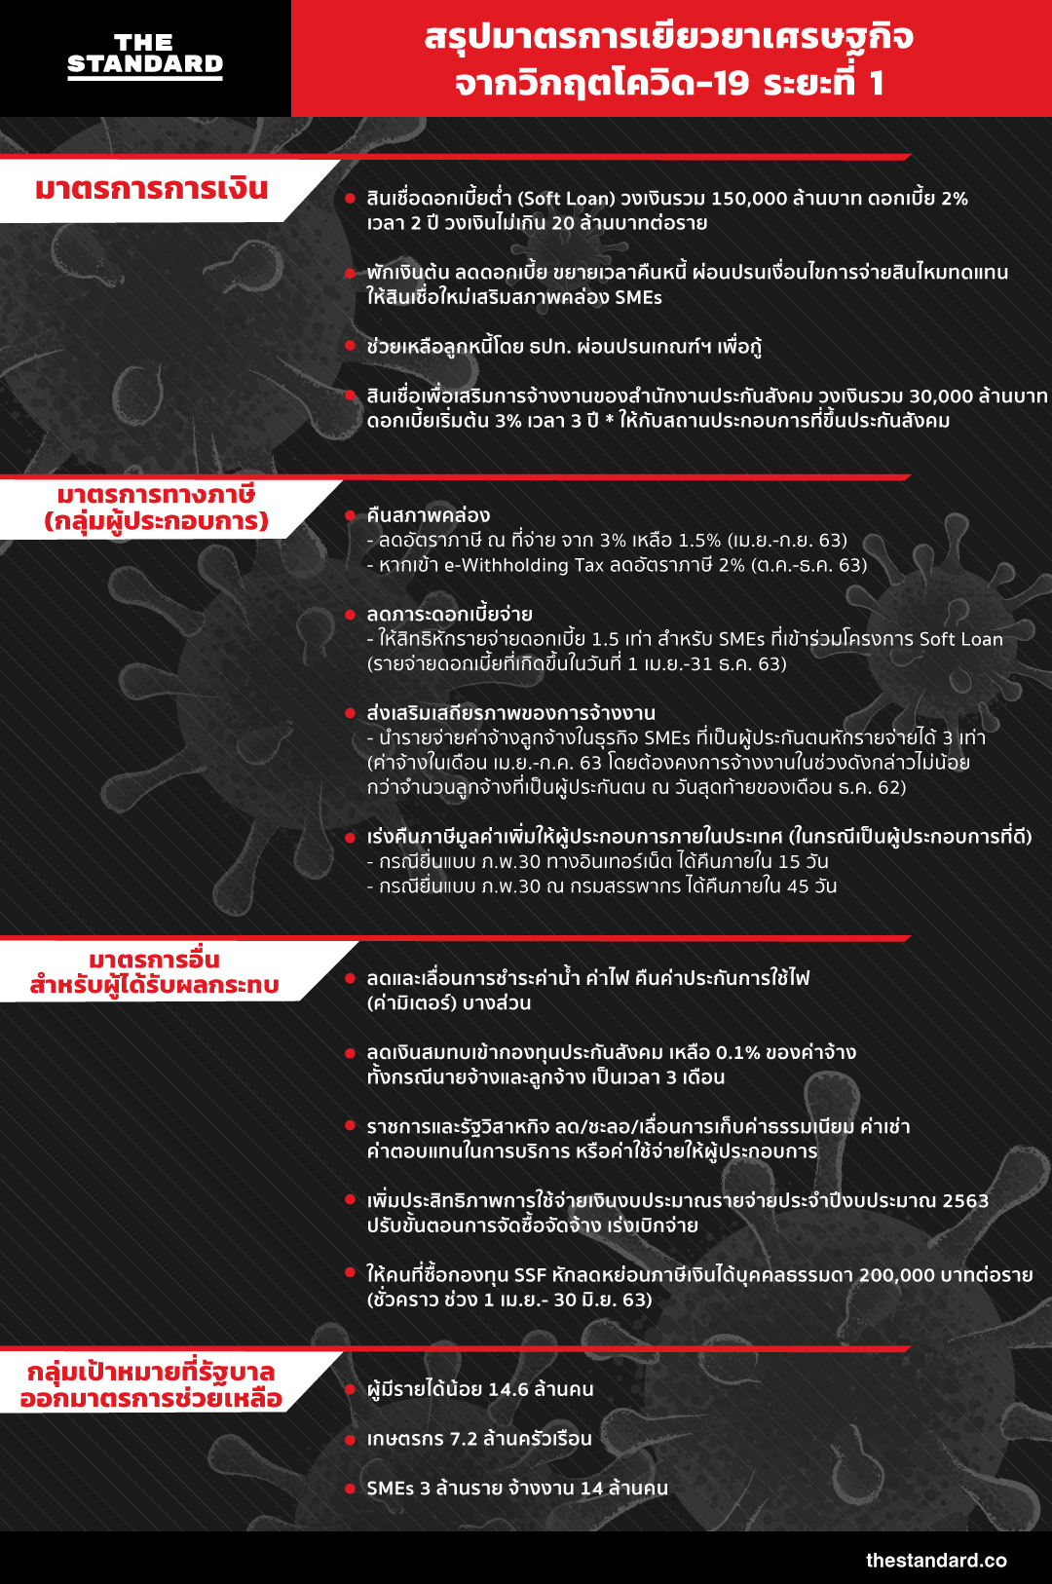
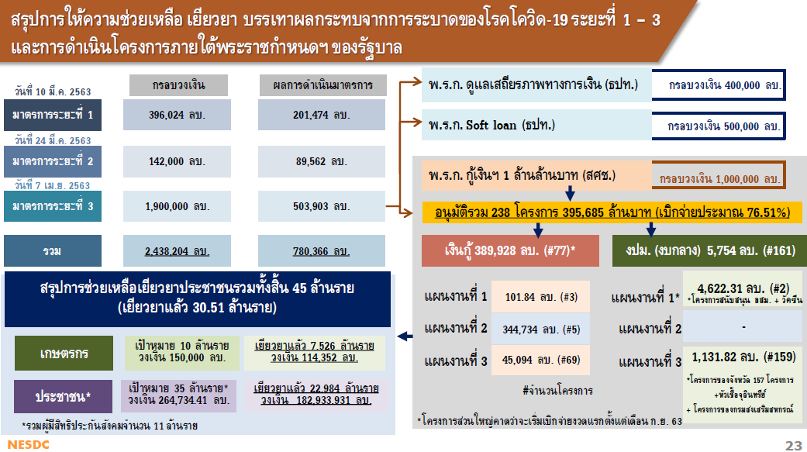
Policy responses
Policy response to help, rehabilitate, and mitigate COVID-19 impact
Policy Response | Budget line (Million Baht) | Disbursement (Million Baht) | Target group
Phase I 10 Mar 2020 | 396,024 | 201,474 | Thais/ Business
Phase II 24 Mar 2020 | 142,000 | 89,562 | Labor (social security insurance)
Phase III 7 Apr 2020 | 1,900,000 | 503,903
Total | 2,438,204 | 780,366
Budget of state enterprises and specialized financial institution
SSI fund
Royal Decree: financial stability (BoT) budget line: 400,000 million baht
Royal decree: Soft loan (BoT) budget line: 500,000 million baht
Royal decree: borrowing 1 trillion baht budget line: 1 trillion baht
Source: NESDC, Sep 21, 2020
14.2% of GDP in 2019

Slide 12
Nine soft loan measures to assist households affected by COVID-19
Phase I
State 1 : April 2020
State 2 : July 2020
For credit card: Reducing minimum payment due From 10% to 5% (end 2021) 8% (2022) 10% (2023) [4.7 M.Acc. 0.2 T.฿]
For Personal loans or Auto title loans: A loan payment holiday of 3 months or reduce 30% of interest rate [3.6 M.Acc. 1.4 T.฿]
For hire purchase or leasing: A loan payment holiday of 3 months or 6 months for principle only (limit 35k฿ - 3 mil.฿ by type of product) [2 M.Acc. 0.7 T.฿]
For housing loans: A loan payment holiday of 3 months and reduce interest rate [limit 3 mil.฿]
[1.2 M.Acc. 1.5 T.฿]
For NPL credit card and Personal loans: A loan payment holiday of 6 months or reduce interest rate -2%
For Non-NPL credit card: reducing interest rate
  12% for credit card
  22% for performing loan
  Reducing minimum payment due to 30%
  Expanding term loans to 48 months
For hire purchase or leasing: A loan payment holiday of 3 months or Expand term loans
  Unlocking limit
For housing loans
  A loan payment holiday of 3 months or
  3 months for principle only with reduced interest rate
  or expand term loans
  Unlocking limit
For NPL credit card and Personal loans
  If remaining debt <50%, can borrow more money

Slide 13
Government Cash Hand-out
Phase II
Government Cash Transfers
 | Total (Million Bt)
Informal sector | 213,000
Agriculture | 111,000
Welfare card | 3,600
Fragile groups | 20,340
Electricity | 32,700
Water | 2,834
Social Security | 229,000
TOTAL | 612,474
Government Cash Hand-out
Government has transferred 612 billion baht (4% of GDP) to almost 30 million Thais from May to July.
The largest number of transfers is for the ‘Nobody will be left behind’ program in which 15,000 baht were transferred to 14.2 million informal sector workers, followed by transfers of Bt15,000 to 7.4 million agriculturists.
612.5
Billion baht
Source: Related ministries and government agencies

Slide 14
Soft loan measures to assist SMEs affected by COVID-19 and to stabilize corporate bond market: 4 measures
Phase III
Measure 1 : A loan payment holiday of 6 months for all SMEs with a credit line not exceeding 100 million baht
Measure 2 : Soft loans to support liquidity for SMEs with a credit line not exceeding 500 million baht
Measure 3 : Market liquidity enhancement to stabilize the corporate bond market
Measure 4 : Reducing the FIDF fee to ease the loan interest burden of businesses and households.
Royal decree: Soft loan (BoT)
budget line: 500,000 million baht
Royal Decree: financial stability (BoT)
budget line: 400,000 million baht

Slide 15
Economic restructuring projects
Phase III
These projects was funded within the budget (the 400 billion baht) from Royal Decree to borrowing 1 trillion baht.
 | Total (Million Bt)
Informal sector | 213,000
Agriculture | 111,000
Welfare card | 3,600
Fragile groups | 20,340
Electricity | 32,700
Water | 2,834
Social Security | 229,000
TOTAL | 612,474
List of approved projects (as of 30 Sep 2020)
  Strengthening grass-root economy (2 projects) 14.59 Billion baht
  Cluster farms & market linkage 13.91 Billion baht
  Tourism promotion (3 projects) 22.40 Billion baht
  Employment Measures
    Co-payment: new employment for 260,000 new graduates
      government support 50% of wages for 12 months
      Maximum 7,500 baht/month
      Total budget is 23.45 Billion baht

Slide 16
II. Macroeconomic impact

Slide 17
Macroeconomic impact
GDP
  Q2/2020 GDP declined by 12.2%yoy basis
  In 2020, Thai economy is expected to contract around 10% this year with impacts from the global economic slowdown and travel restrictions due to COVID-19 pandemic.
  The Inflation rate was -1.7% in Jun 2020.
Export
  total export growth Q2/2020 shrank at -15.2%yoy
  Agricultural export had declined in the first quarter, but increased by 0.3% and 1.7% between April and May 2020, respectively.
Growth of Thai export value by Major Products
Agriculture
Manufacturing
Arms & ammunition
Gold
Other exports
Total exports
Total exports (excl. gold, Arms & ammunition)
Percent

Slide 18
Macroeconomic impact (cont.)
Employment & Unemployment rate
  Employment has dropped by over 1 million in April.
  Unemployment rate increased from an average of 0.8% during 2014-18 to 1.7% in April 2020 in all sectors, especially in construction.
  Unemployment may be 3-5 million in September. (KKP research)
  Number of unemployment benefit claims from the social security schemes rose rapidly since April, reaching over 1.37 million under Article 33 and 0.9 million under Article 75 in the first half of the year.
Unemployment rate (%)
Unemployment benefit claims
under social security scheme Article 33
Percent
Thousand persons
Source: Labor Force Survey and Social Security Office with TDRI calculation

Slide 19
III. Impact on Thai Agriculture

Slide 20



Impact on Thai Agriculture
Direct impact
The direct impact on agriculture GDP was relatively mild, comparing to that on the top three most affected sectors, which are related to the tourist industry
Incomes of agriculture households have also declined with the fall in production from drought, while incomes from non-farm activities (60% of their total incomes) & remittances have also declined due to COVID-19.
15

Slide 21
Impact on Thai agriculture (cont.)
Direct impact (cont.)
The COVID impact on export have both positive & negative effects:
Positive impacts on instant food and dried food e.g. molasses, cocoa
Export of fresh products declined because of interrupted logistics, declining in demand, and export ban on eggs
Source: MOC, June 2020.

Slide 22
Major sources of direct impact on agriculture
Direct impact (cont.)
Thai economy depends heavily on the external sector, especially export and tourism.
  Disruption in international supply chain resulted in temporary declining in export
  Domestic supply chain disruption from lockdown & curfew measures seriously affected fresh produces
  Declining food demand due to declining number of tourists after a ban on international flights (-66.2%yoy from 40 million foreign tourists)
  Declining in domestic demand because of closing business activities, i.e., customers were not allowed to eat in the restaurants & food shops, except take away food service
    - Thus Online sale have been booming e.g. Grab food, Food Panda
    - Curfews also reduced the sale of convenient stores and eating places in the morning and evening

Slide 23
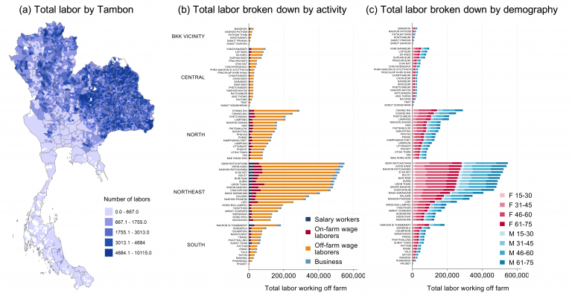
Highly vulnerable because
-80% are casual workers
-45% aged 46-60 years old
(Source: SES, taken from PIER 2020)
But agricultural households are more seriously affected
by the indirect impact of Covid-19
Indirect impact
Employment / income
structure of farm households
65-74% of farm household
income are from non-agric activities
because farm households have
9.58 million workers in non-agricultural sector.
-6.94 mil from the Northeast and the North
Source: PIER 2020

Slide 24
But agricultural households are more seriously affected by the indirect impact of migration
Indirect impact (cont.)
The disappearance of foreign tourists led to a reverse urban-rural migration, because millions of workers in the tourist-related sectors (accommodation & food service, art entertainment & recreation, & transport) become unemployed and had to return to their farm families.
  The number of unemployed workers who returned home may be
  3-5 million (guestimated)
  PIER Survey finds that 75% of farm households have unemployed persons or members with reduced working hours, most of whom from the service sector
    - The North and the South have largest share of such cases (90%), followed by the Northeast (75%) and the Central (70%)
    - The average number of unemployed is 1.5 per household

Slide 25
Why is the indirect impact very large?
Sources of impact
Indirect impact (cont.)
Very large income shock: farm households lost the major source of their income from the non-agricultural sector (65%) and remittance (12% of households)
  Farm income is only 26-35% of agricultural household income (SES and PIER Survey)
  The poorer households depend more heavily on non agri income
Moreover, unemployed family members came home and must live on the 26-35% income from agriculture, which is also affected by Covid-19
Thus agriculture is no longer the sufficient safety net, and poverty will increase sharply.
  In 1997, when urban workers were laid off and returned home, farm income was more than 50% of agricultural household income

Slide 26
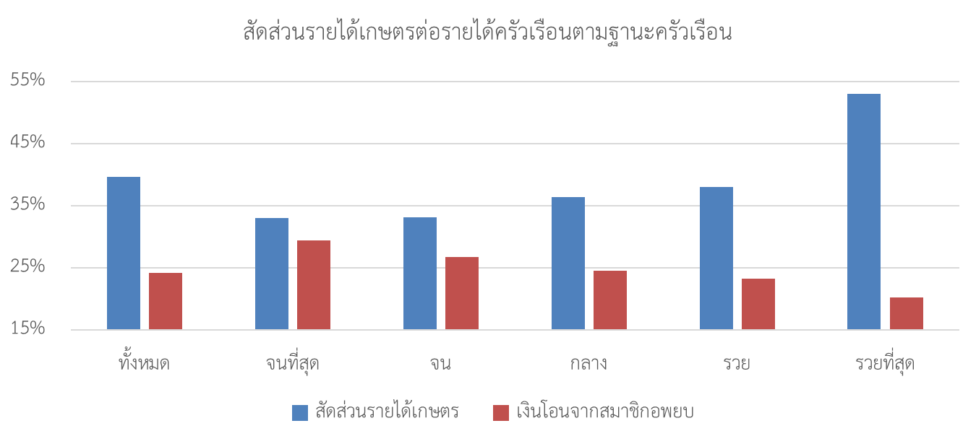
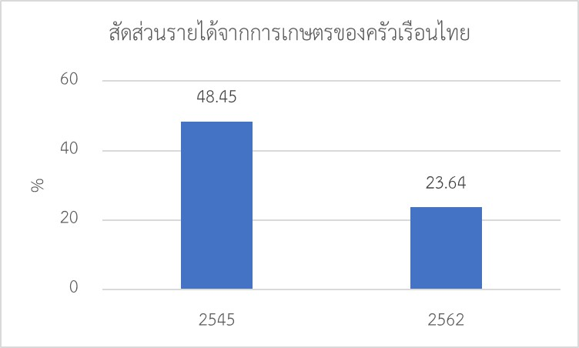
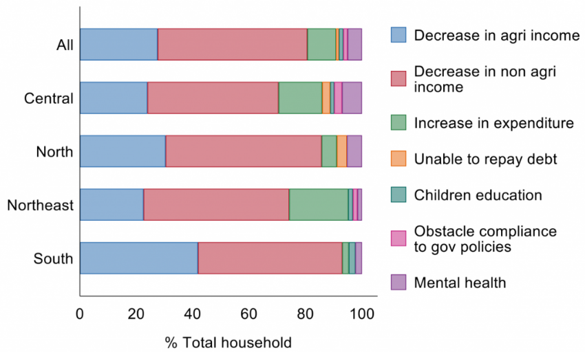
Sources of indirect impact on agriculture (cont.)
Indirect impact (cont.)
The dependence on non agri income of agri households by income status
Farm income is only 26-35% of agricultural household income (SES and PIER Survey)
The poorer households depend more heavily on non agri income.
average
lowest
low
middle
high
highest
Agri income
Non agri income (remittance)
Agri income as percentage for farm household income between 2002 & 2019
The survey about proportion of agri household income 2020
2002
2019
Source: Chantarat et al. (2020)
Notes:
วิกฤตเศรษฐกิจกระทบกลุ่มคนรวยเป็นหลัก ส่วนปี 63 กระทบภาคท่องเที่ยวซึ่งเป็นกลุ่มคนฐานราก

Slide 27
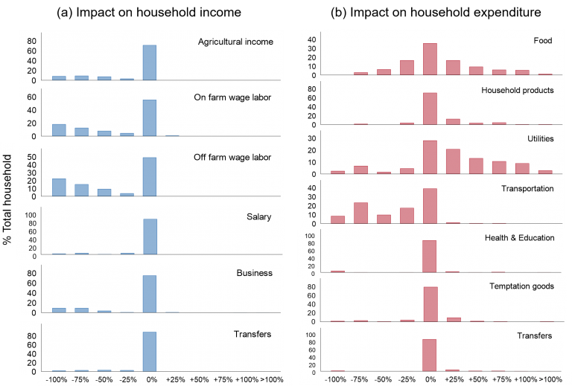
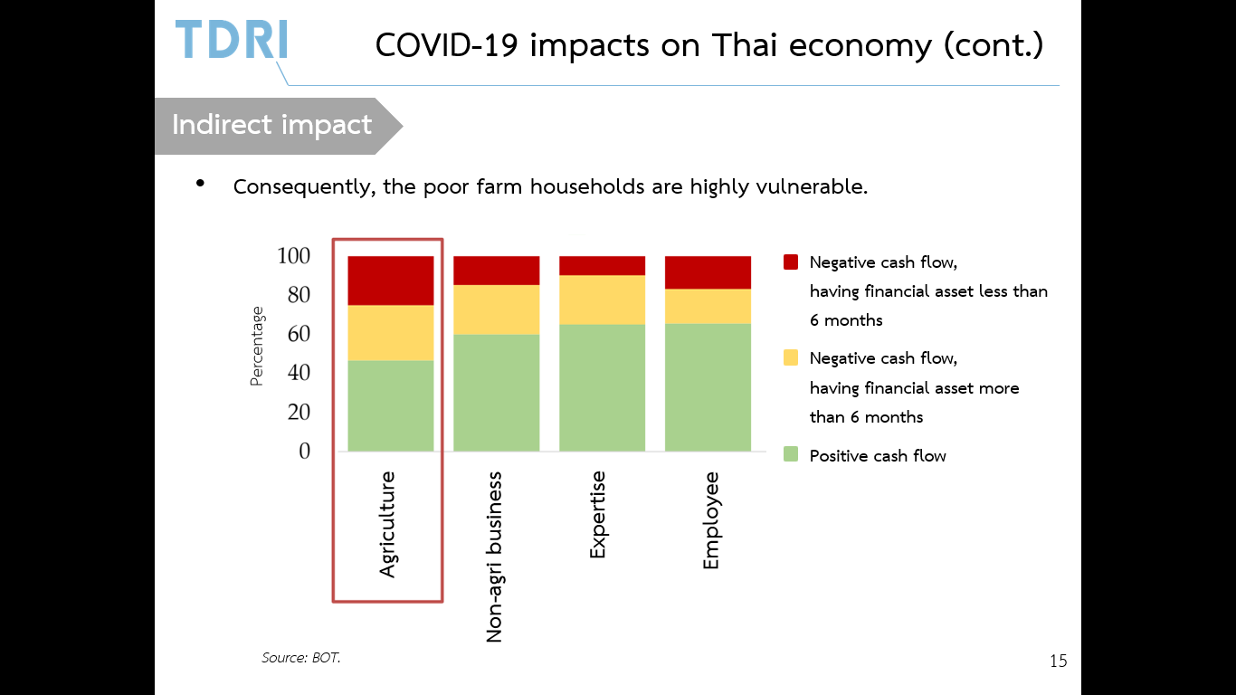
Vulnerability in low-income farm household
Indirect impact (cont.)
Consequently, the farm households, particularly the poor, are highly vulnerable.
Cash flow
Source: BOT.
Source: Chantarat et al. (2020)
Notes:
วิกฤตเศรษฐกิจกระทบกลุ่มคนรวยเป็นหลัก ส่วนปี 63 กระทบภาคท่องเที่ยวซึ่งเป็นกลุ่มคนฐานราก

Slide 28
Farm incomes may recover in 2020H2 but remains less than last year’s
Growth ในตลาดโลก
YoY Growth of Thai Farm income
YoY Growth of Farm income by Crops (5M2020)
Farm incomes in the 5M2020 declined by 1.2% yoy from down in paddy and sugarcane production.
  In 2020H1, Production of rice fell by 35.7% and sugarcane by 14% from severe drought
  Rubber and sugar prices have declined with oil prices.
  This is despite the Bt56 billion transfers under Price Insurance schemes for rice, rubber, cassava , oil palm, maize from Oct 2020 to July 2021.
Farm incomes should recover in 2020H2 but remain lower than last year’s as
  Production and prices recover, but will remain lower than last year’s
Overall incomes of agriculture households will fall this year as 65% of their incomes are from remittances & non-farm work which have collapsed after the COVID-19 outbreak.
Percent
Percent
YoY Growth of Farm income by Crops (2M2020)
-0.7%
Agricultural Production
Global agriculture prices
-6.6%
Million tons
+3.0%
+1.4%
+8.4%
Thousand USD / metric ton
Thousand USD / metric ton
Source: Office of Agricultural Economics with TDRI calculation
Jun
Future price
Source: World Bank

Slide 29
IV. Government Response

Slide 30
Government response
Almost universal cash hand-out of 414 billion baht for 30.5 million individuals from 10 target groups
Financial policy, particularly the soft loan assistance for business and individual borrowers, using 900 billion baht (not discuss here)
Economic stimulus/restructuring policies 400 billion baht

Slide 31
Cash hand-out policy
  Summary of cash hand-out expenditure & sources of fund
 | Bill ฿ |  | Bill ฿
Sources | 414.735 | Use | 297.286
Borrowing Fiscal budget | 344.735 70.00 | Planned | n.a.
Balance (mid Sept. 2020) |  |  | 210.265

Slide 32
Government response : cash hand-out by target groups (cont.)
Targeted groups | Eligible No. (mil) | Reimbursed
 |  | (No.) Mil | Bill baht
Farmers (5,000฿ x 3 m) | 10 | 7.526 | 114.352
NOLB: Employers/self-employed (5,000฿ top up x 3m) | 16 | 15.302 | 159.584
Vulnerable persons (1,000฿ top up x 3 m) | 6.87 | 6.65 | 20.154
Wage compensation for employees | 0.06 | 0.007 | 109 mil
Social security insured employees (not eligible under SSI law) | 59,776 persons | 59,776 persons | 896.64 mil
Social welfare recipient (1,000฿ top up x 3 m) | 1.16 | 1.025 | 3.087
Total (1) | 45.0 | 30.51 | 297.286

Slide 33
Government response : cash hand-out by target groups (cont.)
 | Eligible No. | Reimbursed
 |  | No. | Bill ฿
Additional policies (NOLB budget) Shopping subsidy for social welfare recipients (500฿ x 3m) | 14 | 14* | 21
Shopping subsidy for registered population (100฿/day x 15 days) | 30 | 30* | 45
Social security insurers
Unemployed –force majeure | 0.92 | 0.92 | n.a.
Unemployment benefit | 0.42 | 0.42 | n.a.
Labor protection law (clause 75) | 0.79 | 0.75 | n.a.
Total (2) | 2.1898 | 2.1898
Note : 1) The monthly bills for household electricity and water are also reduced
* September 2020

Slide 34
Question: how many workers are affected by Covid-19 ?
  To assess the effectiveness of cash handout policy, it is necessary to identify the number of workers affected by Covid-19, using the Labor Force Survey
  Method : differences of labor force between Q2/2020 and Q2/2019
  Changes in labor force (million persons)
    Unemployed (increase) +0.368
    Employed (increase) - 0.701
      > 20 hours (-) - 3.635
      1-20 hours (+) + 0.843
      0 hours (+) + 2.081
    Not in labor force (+) +0.413
    Total labor force -0.333
  No. of labor force affected by Covid-19 (1+2.1+2.2+3) is 3.714 million

Slide 35
Some observations
  The figure of 3.174 million workers affected by Covid-19 is seriously underestimated, comparing to unemployed persons under the social insurance system
      No. of affected workers under social insurance system is 0.9 million out of 11 million people (Sept. 2020)
      Temporary work stoppage 1.7 million workers (June 2020)
    Analysts estimate that the number of unemployed and workers with lower working hours may be as high as 11.8 million persons (Bank of Ayuddhaya 2020)
    Informal workers are 18-20 million (50%)
      Most affected workers in the tourist industry are in the informal sector
  Why is the number of affected labor under-estimated ?
    Sampling frame is fixed for 10 years
    Survey method : 60% of respondents
    Definition problems
    People do not cooperate in answering the questionnaire

Slide 36
Research questions
  Why are there so many people (30.5 million) receiving cash handout ?
  Are there any serious errors in the cash transfer administration?
  Do agricultural family members working in non-agricultural sector receive the cash transfer ?
    Does the cash hand-out sufficiently mitigate the short-term liquidity problems of the agricultural households which used to depend heavily on non-agricultural income and remittance from their family members?

Slide 37
Research question1
Why are there 30.5 million people receiving the cash hand out? Populist policy !!!
  The government decided to launch cash handout to all affected workers under the “No one left behind” (NOLH) program and other schemes
    Affected workers were asked to register by answering a short questionnaire
    28 million people registered, including large number of not-in-the labor force (NLF), and 15 mil received the subsidy
    Many people in NLF, indirectly affected as the family prime earners are laid off, also applied
  Government also decided to help 10 million farmers, those under the social welfare card scheme who did not received cash transfer under the NOLH, those under the social insurance scheme, etc.
    In summary there are 10 targeted groups that are eligible for cash handout.

Slide 38
Are there any serious errors in the cash transfer administration
Population
Two types of errors in targeted welfare program
  Inclusion error : Those who are not affected, directly or indirectly, but applied for cash
    Many of 15 million under the NOLB and 7 million registered farmers may be in this group
  Exclusion error : Poor people who failed to register
    Preliminary information's from SES show that 60-64% of poor did not register in the social Welfare Card system
Target group
Non-target
group
Exclusion
error
Right target
Inclusion error

Slide 39
Are there any serious errors in the cash transfer administration?
Two types of error (cont.)
  Unfortunately, since the Ministry of Finance does not disclose the registration information, we can’t tell how large is the error
  Further research is necessary so that the government subsidy scheme can be streamlined in the future.

Slide 40
How serious is the Covid-19 impact on the farm families whose members used to work in the non-agricultural sector?
60-65% of farm household income is from non-agricultural sector, according to SES
A study of Covid-19 impact on farm households, using survey data from 720 households (PIER 2020) shows that
  76% of farm households have income from non-agricultural sector, accounting for 80% of their household income
  40% of farm households depend on remittance
  75% have either laid-off workers or members with reduced working hours
    50% of unemployed workers are in the service sector, 18.7% in construction, 6.3% in trade
    90% of families in the North and South (tourist destinations) and 70% of those in the Northeast and the Central regions have such affected members,
  The average number of affected workers is 1.5 persons per household (out of 3)
  Families with smaller land are affected more than the large ones

Slide 41
A proxy of indirect Covid-19 impact on agri-household : Occupation composition of household members in the agri-household.
Highlights are affected informal workers in tourist-and services industries
Occupations | Total |  | Employment status (% of each occupation)
(in Agricultural Household) | (Mil.) | % | Employer | Own Account, Unpaid Family Workers | Gov't , State Enterprise Employee | Private Employee | Casual workers | Group | Sub total
Executive | 0.27 | 0.9% | 19.2% | 7.5% | 60.9% | 12.1% | 0.0% | 0.2% | 100.0%
Professional | 0.66 | 2.3% | 0.4% | 4.9% | 65.4% | 29.2% | 0.0% | 0.1% | 100.0%
Clerk | 0.33 | 1.1% | 0.1% | 3.1% | 51.6% | 45.1% | 0.1% | 0.0% | 100.0%
Service staff, Cleaning worker and other | 2.10 | 7.1% | 1.1% | 59.4% | 9.3% | 27.4% | 2.7% | 0.0% | 100.0%
Farmers and ag labor | 10.84 | 36.9% | 1.4% | 87.5% | 0.5% | 7.6% | 3.0% | 0.0% | 100.0%
Technician and Machine operator | 1.14 | 3.9% | 2.9% | 27.1% | 2.7% | 63.2% | 3.0% | 1.0% | 100.0%
Food processor, Restaurant worker and Hawker | 0.42 | 1.4% | 0.9% | 73.2% | 0.8% | 24.6% | 0.4% | 0.1% | 100.0%
Construction and transport workers | 0.80 | 2.7% | 0.5% | 16.0% | 5.4% | 71.8% | 5.8% | 0.5% | 100.0%
Non-Labor force | 12.80 | 43.6%
Total | 29.37 | 100% | 0.27 | 11.53 | 1.10 | 3.18 | 0.46 | 0.02
Source: LFS, NSO.

Slide 42
Do most of the affected workers in the non-agricultural sector, who return to their farm family, receive the cash subsidy from any of the cash transfer schemes?
Out of 30.5 million people who received cash subsidy, 7.526 are farmers
PIER (2020) finds that
  76% applied for the agricultural subsidy
  20% of farm households have members under the SSI
  65% applied for the “no one left behind” subsidy
  20% applied for the debt restructuring program of Bank for Agriculture and Agricultural Cooperative (BAAC)

Slide 43
Do most of the affected workers in the non-agricultural sector receive the cash subsidy from any of the cash transfer schemes? (cont.)
Yet 4.2 million unemployed workers, whose household heads registered as the farm households, are not entitled to the NOLH subsidy because their name is in the farm registration
  Despite the fact that they might use to work elsewhere and were not farmer
With the last exception, cash subsidy has more or less mitigated the short-term liquidity problems of most farm families and their members, who are laid off from the non-agricultural sector

Slide 44
V. Implications for the Government

Slide 45
Economic restructuring projects
The government has planned/ is planning the economic restructuring/stimulus program, using the borrowing money of 400 billion baht
  NESDC has already received more than 46,000 proposed projects from government agencies, totaling more than 800 billion baht
    Only 6 projects with 50.9 billion baht budget have been approved.
  The slow approval process may be due to the change in economic ministers and political bargaining
List of approved projects (30 Sept 2020)
  Strengthening grass-root economy (2 projects) 14.594 Bil ฿
  Cluster farms & market linkage 13.905 Bil ฿
  Tourism promotion (3 projects) 22.40 Bil ฿
The first two agricultural related projects are not expected to generate high productivity improvement but will not be discussed here
  Most unemployed workers who return home do not have agricultural skills
  Production of commercial crops have low productivity, etc.

Slide 46
Only Bt38 billion has been approved from the bt400 billion loan
Of the Bt1,448 billion (46,111 projects) proposed, Bt93 billion baht (195 projects) have passed NESDC’s screening, of which 70% are job creation and agriculture-sector projects, 26% are tourism related projects and only 2% are construction projects.
So far, only Bt38 billion or 0.25% of GDP (7 projects) have been approved for implementation by the Cabinet, of which Bt23 billion are tourism-related and the rest agriculture-related projects; most projects are nation-wide and can be disbursed within this September.
For the rest of the year, out of the projects that have passed the NESDC’s screening, those that can be quickly implemented will be prioritized such as in agriculture, job creation and SME business promotion
(the latter is Bt2 billion).
PROJECT NAME | ACTIVITY | IMPLEMENTED AREAS | BUDGET (Billion Baht) | EXPECTED 2020 DISBURSEMENT (Billion Baht)
We Travel Together | Increase consumption and boost tourism sector | All provinces | 20 | 20
Kumlungjai | Increase consumption and boost tourism sector | All provinces | 2.4 | 2.4
Developing Potential in Wildlife Tourism | Develop quality tourism | 157 wildlife refuges (57 provinces) | 7.4 | 0.4
Safe Tourism Zones | Develop quality tourism | Potential provinces | 0.15 | 0.06
One Tambon 1 New Agricuture Theory | Develop New Agriculture Theory: self-dependence | All provinces | 9.8 | 3.9
Developing model areas in promoting quality of life according to the new agriculture theory towards the “Kok Nong Na Model” | Develop New Agriculture Theory: self-dependence | All provinces | 4.9 | 3.1
Developing One Stop Service for Soil and Fertilizer for Communities | Develop large and modern agriculture | All provinces | 0.2 | 0.06
Source: Compiled by TDRI; Disbursements calculated by TDRI

Slide 47
Economic restructuring projects and major concerns
Three major concerns
  1) It is extremely difficult, if not impossible, to restructure the tourism-dependent economy in the short-term due to many rigidities and adjustment costs
    Thailand depended heavily on tourism, which is the second largest income-generating sector with 40 million tourists
    It will take at least 2-3 years for tourism to recover
    Yet it is unreasonable to expect a full recovery and back to a normal business
    As long as the international travel ban is not lifted (due to the public fear of second wave of Covid-19 infection),
      millions of workers will be unemployed, resulting in miserable lives of their families
      ten of thousands of SMEs will be bankrupted
      social unrest will be uncontrollable
      Economic crisis will be unavoidable

Slide 48
Three major policy concerns (cont.)
  2) Except the recently approved employment projects for the newly college graduates and agricultural projects, the restructuring programs do not yet have any concrete employment creation projects that can create employment for more than 7-8 million workers in the tourist-related industry?
    Most workers have low skill and low education
    They do not have any agricultural skills because they left their farms when they were young
  3) Another concern is that most of the 46,000 projects proposed by the government agencies may not be the sound projects
    Most failed to be financed under the fiscal budget proposal
    They are mainly proposed by the government agencies with no/ or little process of participation by stakeholders
    The large number of projects reflect the fragmentation problems, competition for budget and thus lack of integrated policies
    Yet the economic stimulus/ restructuring program will be the largest stimulus / restructuring package in modern history of Thai economic policy, using 400 billion baht of loan
    The stake for Thai people, the economy and the government is extremely high
      Thailand cannot afford the failure

Slide 49
Three challenging issues
  1) Should Thailand adopt a more liberal tourism program (than the current “Special Visa Tourist Program which can only attract a few hundreds of millionaire tourists) to attract large number of tourists from highly selected countries?
    Allowing foreign tourists from a few highly selected countries to visit Thailand without a 14-day quarantine, but with the Covid-19 PCR tests
    A recent BOT study (2020) shows that allowing 30% more tourists will reduce NPL of all borrowers from 10% to 6.5%, but with higher risk of Covid-19 infection
    There is an urgent need for a cost-benefit and risk management study that evaluate the health risk and associated costs, and the economic benefits of the program
  2) What kinds of projects that can create employment for more than 7-8 million workers in the tourist-related industry?
    How should the projects create employment and necessary skills for most of unemployed workers in the tourism-related industries?
    What kinds of skill retraining programs that are suitable to the behavior of unemployed workers (mostly with secondary education) in the service sector, as well as the type of skills that are demanded by the small business in the informal sector?

Slide 50
Three challenging issues (cont.)
3) Given the serious problems in the proposed economic stimulus/ restructuring projects, should the government consider revamping the current 46,111 projects proposed by the government agencies?
  So far, the government has not used necessary and more reliable data as well as empirical evidence to formulate the projects because they were hurriedly proposed in a few weeks.
    Sadly speaking, the government did not make use of the information obtained from 28 million people who applied for the cash handout
      It contains the data on their employment situation and demographic characteristics, etc.
    Will the new economic ministers re-consider those 46,111 projects?
    If yes, what kind of restructuring projects ?
  How should the new projects be formulated so that they meet the challenging issues?
    E.g. participation of key stakeholders (at provincial level) in the process of project formulation & implementation
    Decentralization of the project proposal process with a guideline from the central government
  How should the projects be monitored?
    Proposed projects must contain clear objectives and achievable targets that can be measured
  Etc.

Slide 51

nipon@tdri.or.th
urairat@tdri.or.th

Slide 52


